Slide 1
BELLEZA WEBAPP
Software Engineering final presentation
Group 9

Slide 2
Overview
Purpose: The project aims create an interactive webapp to book saloon appointments.
Goals: The goal of this application is to ease the process of booking saloon appointments in a very effective and reliable manner.

Slide 3
DEVELOPMENTAL PHASE

Slide 4
SDLC Model
Agile
Incremental and iterative
SCRUM model: best for the given project within the given time limit

Slide 5
Main modules
Login | Live Status | Later Status | Booking | Manager
Google API | Details Required: Date and Time of booking | Details Required: Date and Time of booking | List Services | View Current Status
Virtual Table | Display: Live status of the seats | Display: Later status of the seats | Option to book a latter appointment | Manage bookings
 | Option to instantly book a seat | Option to book a seat | book instantly | Mail Appointment Details

Slide 6
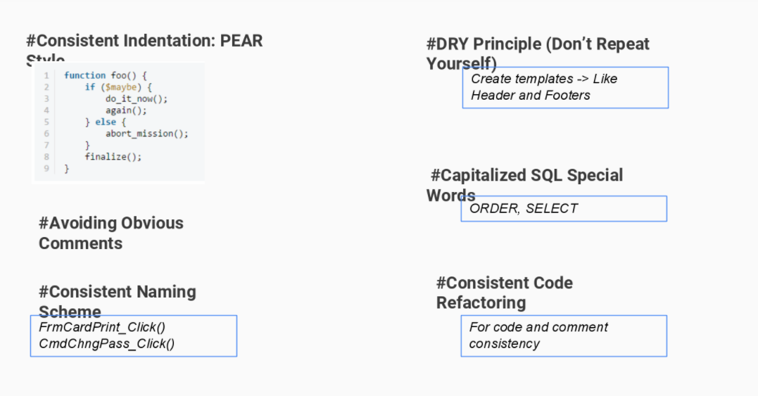
Coding Standards

Slide 7
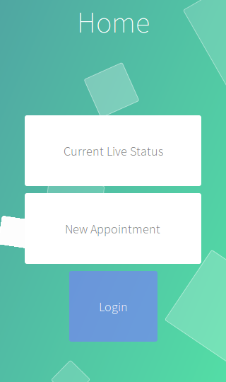
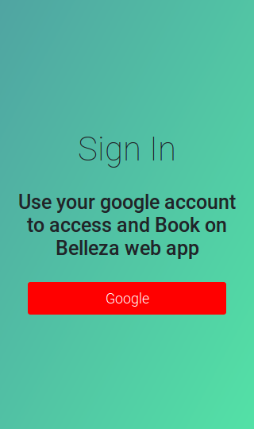
Project Screenshots
HOME SCREEN
After Clicking
Login
This is the main landing page of our website.
User needs to sign in to book a new appointment or check their activity history
Notes:
1

Slide 8
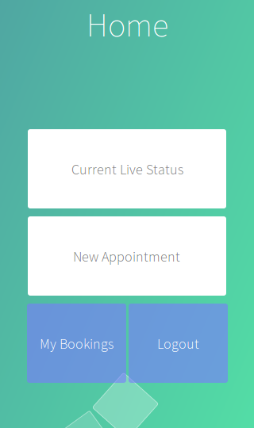
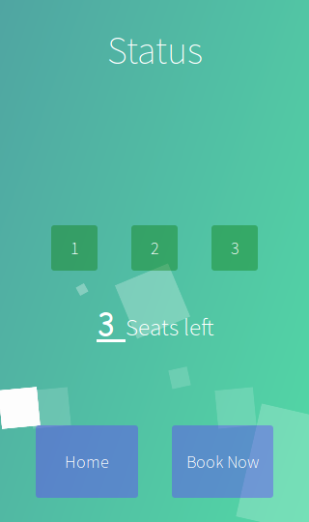
Project Screenshots
Home Screen
Current live
Status Screen
After logging in,
The user can book a new appointment or Check his history of booking
Or check the current live status
User can see the current status and choose to book an appointment for now.
Notes:
1

Slide 9
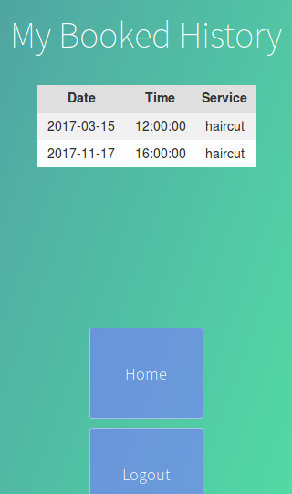
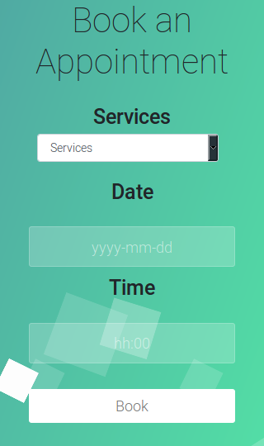
Project Screenshots
Booking History
Screen
Book a new
Appointment
User can check its booking history where all old booking will be displayed along with the service and date-time of the booking.
Here, the user can select services and date-time for the booking and it will show whether he/she can or cannot book.
Notes:
1

Slide 10
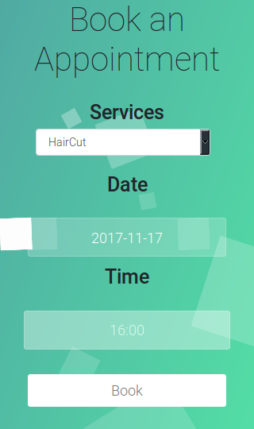
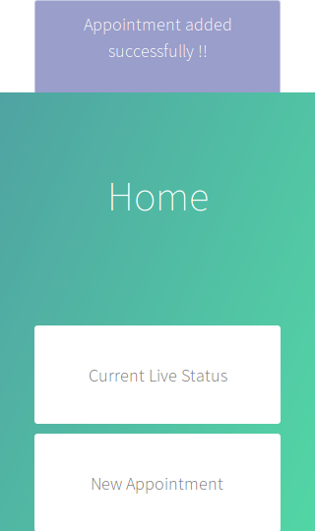
Project Screenshots
Booking Screen
Appointment
Successful
User can select various services offered in the drop down menu.
He/She has to enter date-time in the specified format.
After the appointment is successfully booked, user sees a prompt for that booking.
He/she can now see it in his MyBookings tab.
Notes:
1

Slide 11
TESTING PHASE

Slide 12
Testing Phase
UNIT TESTING
SYSTEM TESTING
FORCED ERROR TESTING

Slide 13
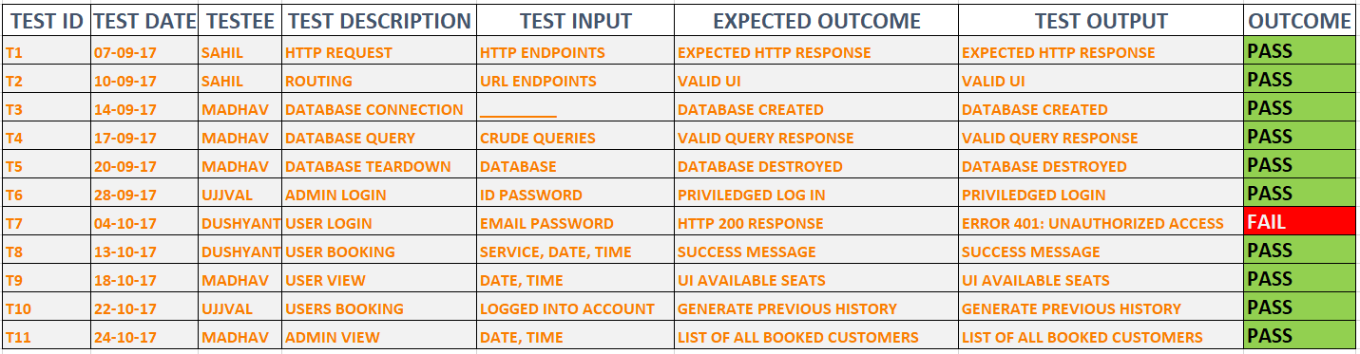
Unit Testing

Slide 14
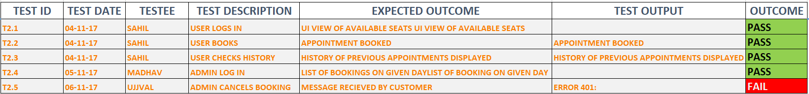
System Testing

Slide 15
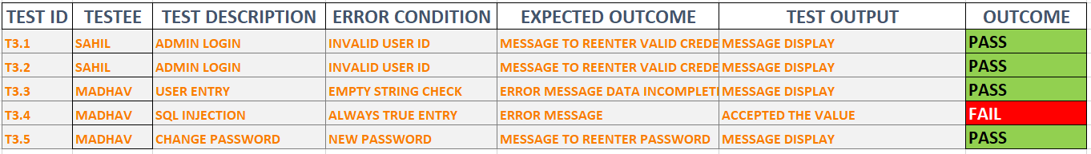
Forced Error Testing

Slide 16
TEAM ANALYSIS

Slide 17
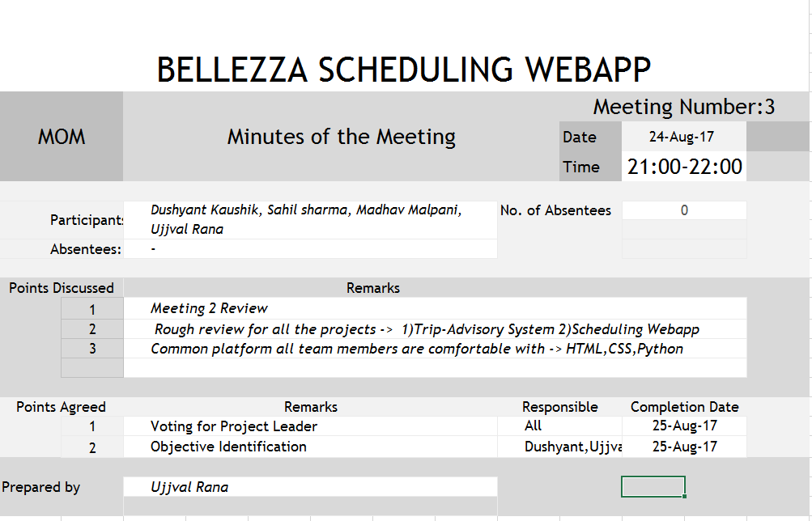
Glimpses of MOM

Slide 18
Tools used by team
Github
Atom Editor
Teletype
Smart draw
Microsoft Excel, Powerpoint
Bootstrap
Git-bash

Slide 19
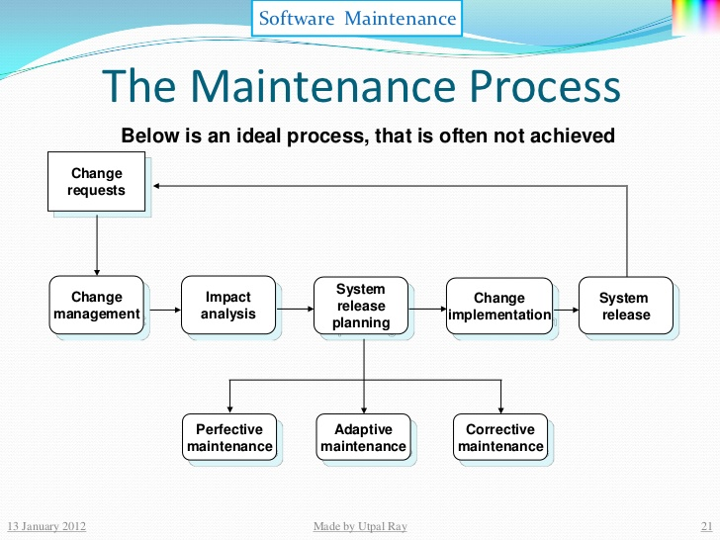
Maintenance
Code Cleaning
Document maintenance
Google API update
Changing the code as per client request

Slide 20
Future aspects
Technical
More secure and efficient environment
Database upgrade
Additional features
Auto-suggestion, integrated payment, packages
Economical
More feasible
More user friendly
Privacy
Becoming more independent
Removing external reference and APIs usage

Slide 21
THANK YOU
Mrs Singdha Biswas
Mentor, Faculty
Software Engineering (Monsoon, ’17)

